Slide 1
Truth Discovery and Veracity Analysis
Jiawei Han
Computer Science
University of Illinois at Urbana-Champaign
March 30, 2017

Slide 2


Slide 3
Outline
Motivation: Why Truth Finding?
TruthFinder: A Source-Claim-Object Network Framework
Truth Finding: Variations and Extensions
LTM: Latent Truth Model (Modeling Multi-Valued Truth and Two-sided Errors)
GTM: A Gaussian Truth Model for Finding Truth among Numerical Data
Conclusions and Future Research

Slide 4
Why Truth Finding?
We are in the Web and “Big Data” age
Lots of information: Also, lots of errors and false information!
Lots of information providers: Not every one is 100% reliable
When encountering conflicting information on the same entities
Which piece of info is correct?
Which sources are trustable?
Challenges: We want to get trusted information!
Training on millions of pieces of information?
Too expensive, unrealistic!
Trust on “trusted” sources?
Everyone can make mistakes, even for the majority

Slide 5
Outline
Motivation: Why Truth Finding?
TruthFinder: A Source-Claim-Object Network Framework
Truth Finding: Variations and Extensions
LTM: Latent Truth Model (Modeling Multi-Valued Truth and Two-sided Errors)
GTM: A Gaussian Truth Model for Finding Truth among Numerical Data
Conclusions and Future Research

Slide 6
Truth Validation by Info Network Analysis
The trustworthiness problem of the web (according to a survey):
54% of Internet users trust news web sites most of time
26% for web sites that sell products
12% for blogs
TruthFinder: Truth discovery on the Web by link analysis
Among multiple conflict results, can we automatically identify which one is likely the true fact?
Veracity (conformity to truth):
Given a large amount of conflicting information about many objects, provided by multiple web sites (or other information providers), how to discover the true fact about each object?
Our first work: Xiaoxin Yin, Jiawei Han, Philip S. Yu, “Truth Discovery with Multiple Conflicting Information Providers on the Web”, TKDE’08

Slide 7
Conflicting Information on the Web
Different websites often provide conflicting info. on a subject, e.g., Authors of “Rapid Contextual Design”
Online Store | Authors
Powell’s books | Holtzblatt, Karen
Barnes & Noble | Karen Holtzblatt, Jessamyn Wendell, Shelley Wood
A1 Books | Karen Holtzblatt, Jessamyn Burns Wendell, Shelley Wood
Cornwall books | Holtzblatt-Karen, Wendell-Jessamyn Burns, Wood
Mellon’s books | Wendell, Jessamyn
Lakeside books | WENDELL, JESSAMYNHOLTZBLATT, KARENWOOD, SHELLEY
Blackwell online | Wendell, Jessamyn, Holtzblatt, Karen, Wood, Shelley

Slide 8
Our Setting: Info. Network Analysis
Each object has a set of conflictive facts
E.g., different author names for a book
And each web site provides some facts
How to find the true fact for each object?
Web sites
Facts
Objects
w₁
f₁
o₁
f₂
w₂
f₃
w₃
f₄
o₂
w₄
f₅

Slide 9
Basic Heuristics for Problem Solving
There is usually only one true fact for a property of an object
This true fact appears to be the same or similar on different web sites
E.g., “Jennifer Widom” vs. “J. Widom”
The false facts on different web sites are less likely to be the same or similar
False facts are often introduced by random factors
A web site that provides mostly true facts for many objects will likely provide true facts for other objects

Slide 10
Overview of the TruthFinder Method
Confidence of facts ↔ Trustworthiness of web sites
A fact has high confidence if it is provided by (many) trustworthy web sites
A web site is trustworthy if it provides many facts with high confidence
The TruthFinder mechanism, an overview:
Initially, each web site is equally trustworthy
Based on the above four heuristics, infer fact confidence from web site trustworthiness, and then backwards
Repeat until achieving stable state

Slide 11
Analogy to Authority-Hub Analysis
Facts ↔ Authorities, Web sites ↔ Hubs
Difference from authority-hub analysis
Linear summation cannot be used
A web site is trustable if it provides accurate facts, instead of many facts
Confidence is the probability of being true
Different facts of the same object influence each other
Web sites
Facts
High trustworthiness
w₁
f₁
High confidence
Hubs
Authorities

Slide 12
Inference on Trustworthness
Inference of web site trustworthiness & fact confidence
Web sites
Facts
Objects
w₁
f₁
o₁
w₂
f₂
w₃
f₃
o₂
w₄
f₄
True facts and trustable web sites will become apparent after some iterations

Slide 13
Computation Model: t(w) and s(f)
The trustworthiness of a web site w: t(w)
Average confidence of facts it provides
The confidence of a fact f: s(f)
One minus the probability that all web sites providing f are wrong
Sum of fact confidence
t(w₁)
w₁
Set of facts provided by w
s(f₁)
f₁
t(w₂)
w₂
Probability that w is wrong
Set of websites providing f

Slide 14
Experiments: Finding Truth of Facts
Determining authors of books
Dataset contains 1265 books listed on abebooks.com
We analyze 100 random books (using book images)
Case | Voting | TruthFinder | Barnes & Noble
Correct | 71 | 85 | 64
Miss author(s) | 12 | 2 | 4
Incomplete names | 18 | 5 | 6
Wrong first/middle names | 1 | 1 | 3
Has redundant names | 0 | 2 | 23
Add incorrect names | 1 | 5 | 5
No information | 0 | 0 | 2

Slide 15
Experiments: Trustable Info Providers
Finding trustworthy information sources
Most trustworthy bookstores found by TruthFinder vs. top-ranked bookstores by Google (query “bookstore”)
TruthFinder
Bookstore | trustworthiness | #book | Accuracy
TheSaintBookstore | 0.971 | 28 | 0.959
MildredsBooks | 0.969 | 10 | 1.0
Alphacraze.com | 0.968 | 13 | 0.947
Google
Bookstore | Google rank | #book | Accuracy
Barnes & Noble | 1 | 97 | 0.865
Powell’s books | 3 | 42 | 0.654

Slide 16


Slide 17
Outline
Motivation: Why Truth Finding?
TruthFinder: A Source-Claim-Object Network Framework
Truth Finding: Variations and Extensions
LTM: Latent Truth Model (Modeling Multi-Valued Truth and Two-sided Errors)
GTM: A Gaussian Truth Model for Finding Truth among Numerical Data
Conclusions and Future Research

Slide 18
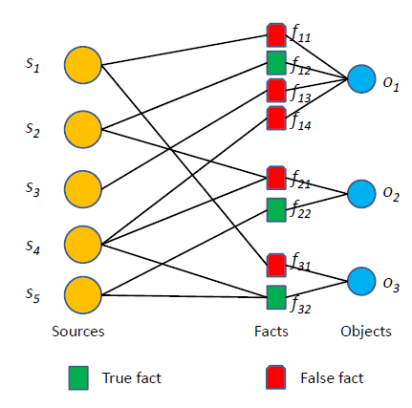
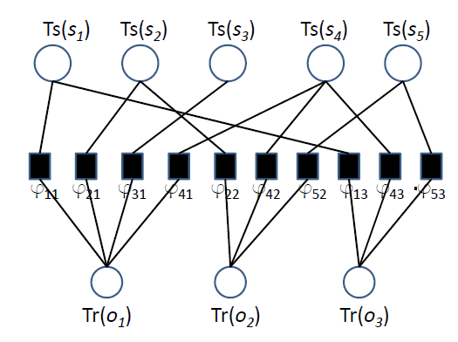
Mining Collective Intelligence in Groups: Latent Dirichlet Truth Discovery
Explicitly exploit the fact-object hierarchy
Considers all the facts as a whole for each object
Model the behavior of both trustworthy and untrustworthy sources explicitly
A Source-Claim-Object Framework
Guo-Jun Qi, Charu C. Aggarwal, Jiawei Han, and Thomas Huang, "Mining Collective Intelligence in Groups", WWW'13, May 2013

Slide 19
An Expectation Maximization Framework
Participant (or Source)
Estimation Theory
Assertion (or Measured Variable) [Binary]
S₁
C₁
Expectation Maximization
S₂
C₂
# of True assertions /Total # of assertions a participant claims
Probability an assertion is true
S₃
Optimal Estimation?
C₃
…
Maximum Likelihood Estimation
…
S_{i}C_{j}=1
Participant Reliability
Assertion Correctness
S_{i}
C_{j}
S_{i+1}
C_{j+1}
Hypothesis that is mostly
consistent with observations
Observation Matrix
S_{M}
C_{N}
D. Wang, L. Kaplan and T. Abdelzaher, “On Truth Discovery in Social Sensing with Conflicting Observations: A Maximum Likelihood Estimation Approach”, ACM Transaction on Sensor Networks (TOSN), 2014

Slide 20
Generalized Fact-Finding: Considering Additional Information
Ex: “Obama was born in Hawaii” vs. “Obama was born in Kenya”
Uncertainty in the claims: “I’m 90% sure Obama was born in Hawaii”
Attributes of sources: The source making the first claim is Authority
Similarity between claims: A source claiming “Kenya” implicitly prefers neighboring “Uganda” over “Hawaii”
Key Features: J. Pasternack and D. Roth, “Making Better Informed Trust Decisions with Generalized Fact-Finding“, IJCAI’11
Consider Additional/Background Knowledge in Fact-finding (e.g., source uncertainty, claim similarity, group information)
Model Additional Knowledge as Link Weights to Generalize Fact-finding algorithms
Generalize bi-partite graph to k-partite graph to consider source groups or attributes

Slide 21
Truth Discovery and Copying Detection in a Dynamic World
Luna Dong’s series work on truth discovery and data integration
Find true values and determine the copying relationship between sources (VLDB’09)
Quality of sources over time: coverage, exactness and freshness
Use hidden Markov model (HMM) to decide whether a source is a copier of another and identifies the specific moments it copies
Use a Bayesian model that aggregates info from sources to decide the true value for a data items and the evolution of the true value over time
Further study on truth finding on the Web (e.g., VLDB’13)
Lot of inconsistencies on even deep web, in some highly “trusted” domains, e.g., stock and flight
For 70% of data items, > 1 value is provided: Widely open!

Slide 22


Slide 23
Outline
Motivation: Why Truth Finding?
TruthFinder: A Source-Claim-Object Network Framework
Truth Finding: Variations and Extensions
LTM: Latent Truth Model (Modeling Multi-Valued Truth and Two-sided Errors)
GTM: A Gaussian Truth Model for Finding Truth among Numerical Data
Conclusions and Future Research

Slide 24
From TruthFinder to Latent Truth Model (LTM)
HITS-like Random Walk methods (e.g., TruthFinder(KDD’08), 3-Estimate(WSDM’10), Invest(COLING’10), …)
Higher Quality Sources ↔ More Probable Facts
Limitations
Quality as a single value: Precision or Accuracy
In practice, some sources tend to ignore true attributes (False Negatives), while some others tend to produce false attributes (False Positives).
FN ǂ FP when there are multiple truths per entity!
LTM (Latent Truth Model): Bo Zhao, Benjamin I. P. Rubinstein, Jim Gemmell, and Jiawei Han, "A Bayesian Approach to Discovering Truth from Conflicting Sources for Data Integration", VLDB'12
LTM: A Principled Probabilistic Model
Model negative claims and two-sided source quality with Bayesian regularization

Slide 25
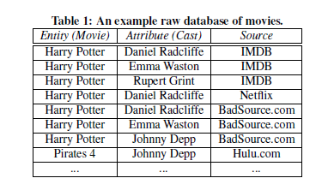
What Is Latent Truth Model?
Different but real situations (new assumptions)
Multiple facts can be true for each entity (object)
One book may have 2+ authors
A source can make multiple claims per entity, where more than one of them can be true
A source may claim a book w. 3 authors
Sources and objects are independent respectively
Assume book websites and books are independent
The majority of data coming from many sources are not erroneous
Trust the majority of the claims

Slide 26
Challenge: Why Voting Does Not Work?
Input:
Facts = (Entity, Attribute)
Claims = (Relation, Source, Observation)
Output: Truth(Relation) → {1, 0}
Many sources are not of high quality: Cannot trust all sources in voting
Movie: Harry Potter and the Deathly Hallows
IMDB: Daniel Radcliffe, Emma Watson
Nexflix: Daniel Radcliffe
BadSource.Com: Daniel Radcliffe, Johnny Depp
RID | Source | Obs.
1 | IMDB | 1
2 | IMDB | 1
3 | IMDB | 0
1 | Netflix | 1
2 | Netflix | 0
3 | Netflix | 0
1 | BadSource | 1
2 | BadSource | 0
False Negative (threshold = 0.5)
False Positive (threshold = 0.3)
RID | Entity | Attribute
1 | HP7 | Daniel Radcliffe
2 | HP7 | Emma Watson
3 | HP7 | Johnny Depp
Optimal Threshold?
RID | Truth
1 | 1
2 | 1
3 | 0
Input: Fact Table
Output: Truth Table
Input: Claim Table

Slide 27
Multiple Truths for Same Entities
Implicit negative claims by source s:
For those facts not claimed true by source s, but by some other sources
Modeling negative claims and two-sided errors (false positives, false negatives) is essential for supporting multiple truths:
Negative claims can help detect false attributes
Negative claims by high recall sources are usually very accurate, e.g., IMDB
Negative claims by low recall sources should not count much, e.g., Netflix
Thus, LTM Naturally supports multiple true attribute values
LTM can naturally incorporate prior domain knowledge through Bayesian priors
An efficient and scalable linear complexity inference algorithm
LTM can run in either batch or online streaming modes for incremental truth finding
Positive Claim
A
Positive Claim
Source
Source
B
Negative Claim
Positive Claim

Slide 28
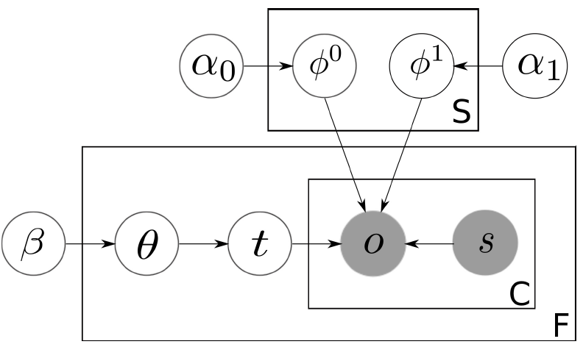
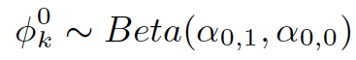
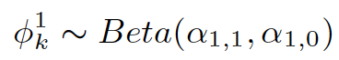
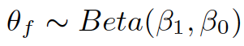
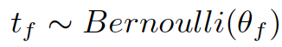
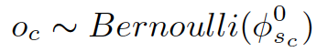
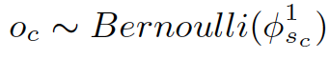
The Latent Truth Model
For each source k
Generate false positive rate (with strong regularization, believing most sources have low FPR):
Generate its sensitivity (1-FNR) with uniform prior, indicating low FNR is more likely:
For each fact f
Generate its prior truth prob, uniform prior:
Generate its truth label:
For each claim c of fact f, generate observation of c.
If f is false, use false positive rate of source:
If f is true, use sensitivity of source:
Quality of Sources
Observation of Claims
Truth of Facts
Graphical Representation

Slide 29
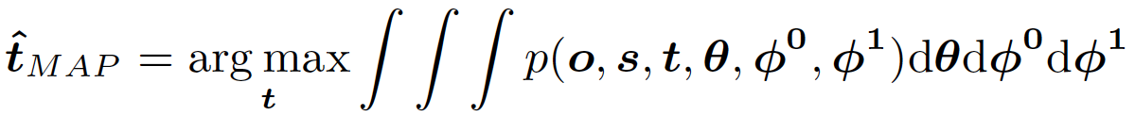
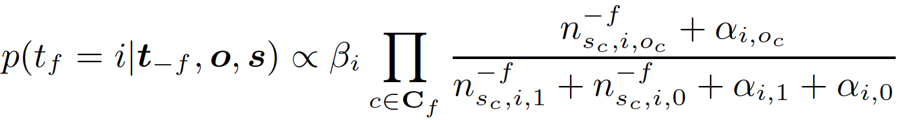
Inferring Truth
MAP inference: find truth assignment that maximizes posterior probabilities
Collapsed Gibbs sampling (more efficient, only sample truth, other parameters integrated out)
Prediction of the truth from samples of the latent truth variable.
Burn-in: throw away first b samples
Thinning: Take every k sample from all the samples
Calculate expectation of the taken samples

Slide 30
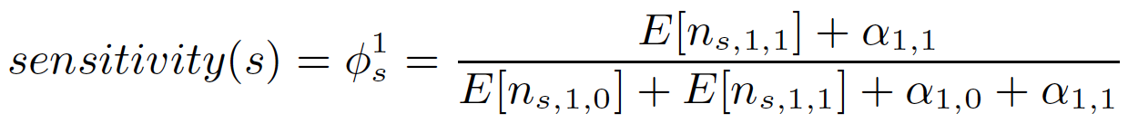
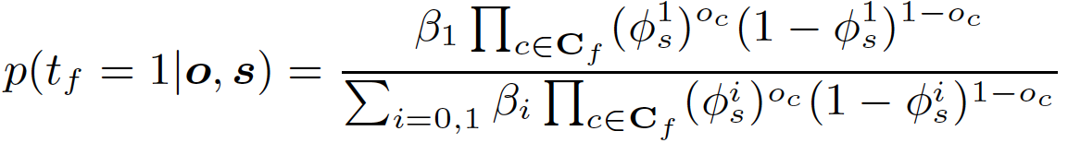
Incremental Truth Finding
Read-off Source Quality Parameters
Incremental Prediction (LTMinc)
Assuming source quality unchanged, directly utilize source quality to make prediction (very efficient)
Can also rerun inference for incremental update by using previous quality counts as Bayesian priors

Slide 31
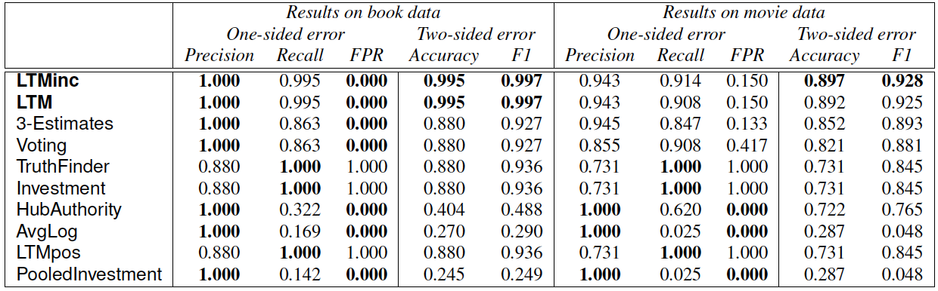
Experiments (Effectiveness)
Datasets:
Book Authors from abebooks.com (1263 books, 879 sources, 48153 claims, 2420 book-author, 100 labeled)
Movie Directors from Bing (15073 movies, 12 sources, 108873 claims, 33526 movie-director, 100 labeled)

Slide 32
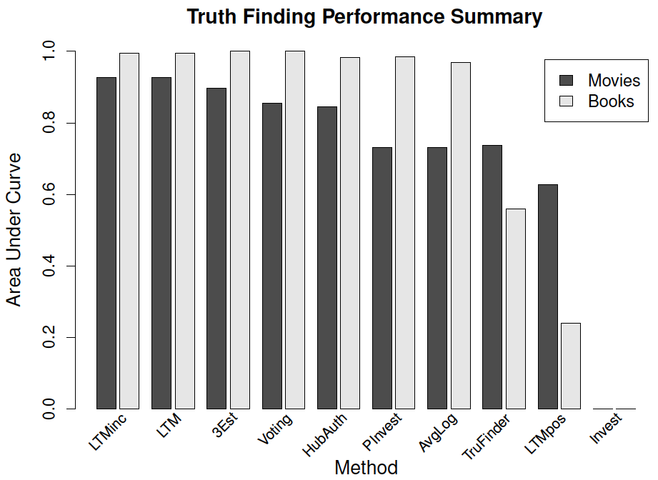
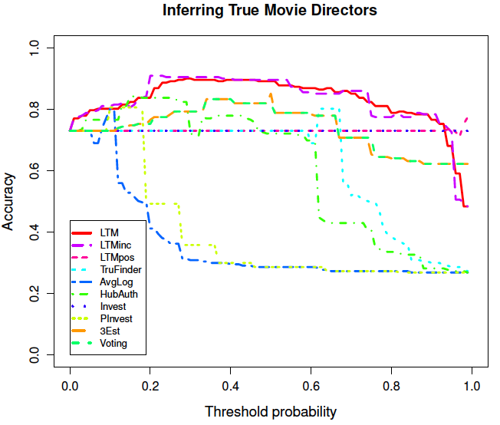
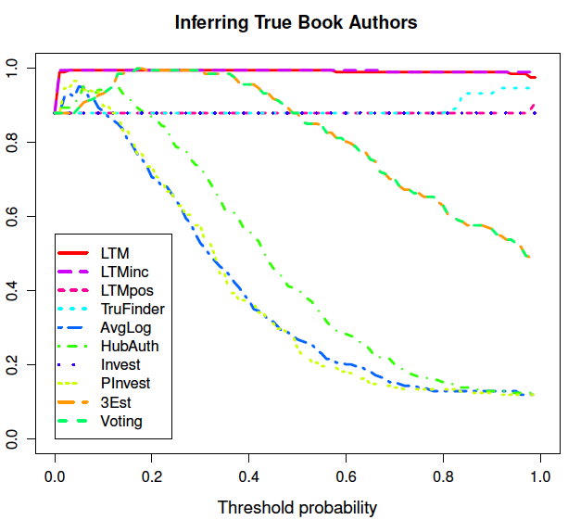
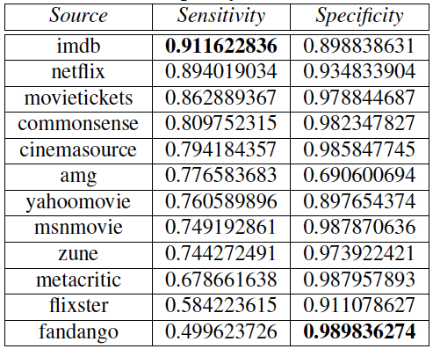
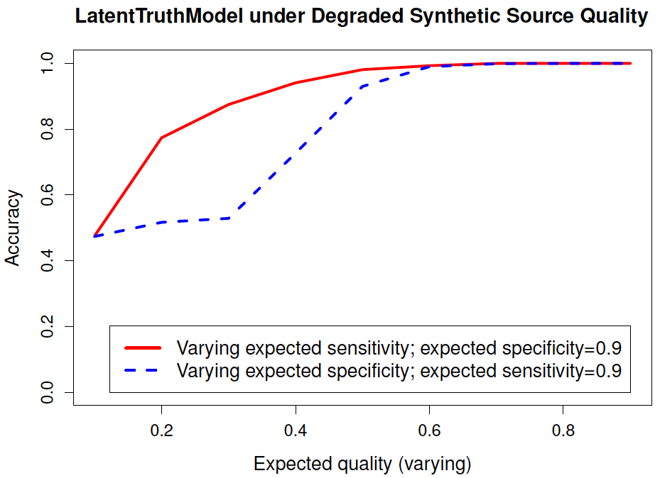
Experiments (Effectiveness) cont.
Varying cutoff threshold (consistently better)
AUC
Case Study of Movie Sources
Varying synthetic quality (more tolerant of low sensitivity)

Slide 33
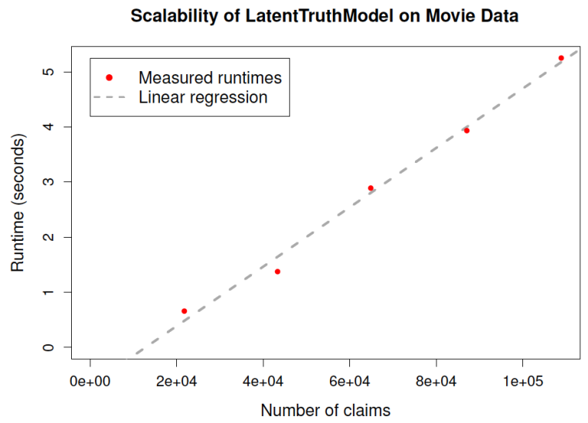
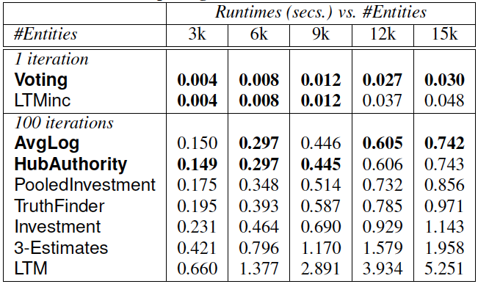
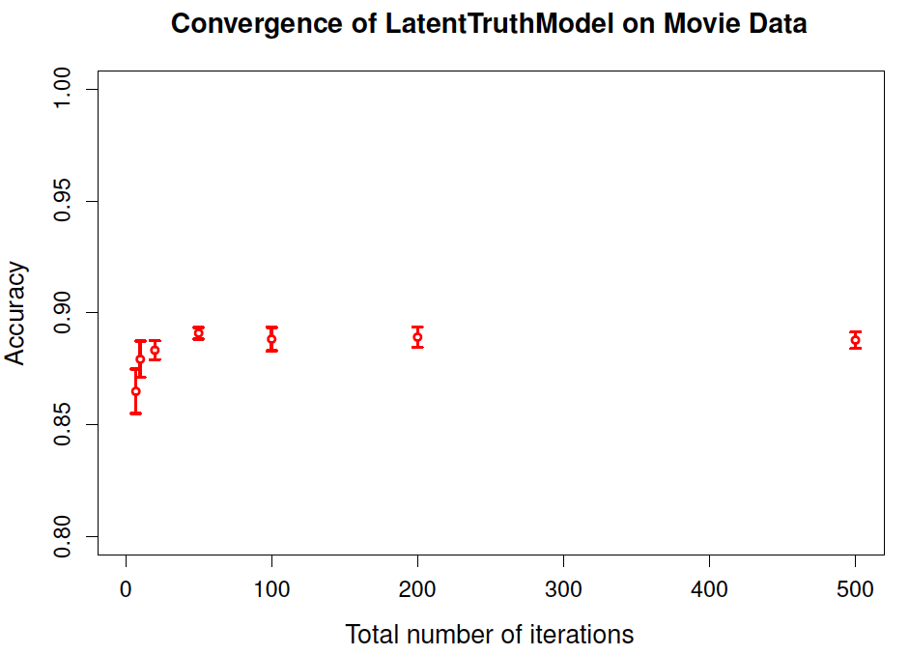
Experiments (Efficiency)
Runtime vs. Data Size (linear)
Running Time
Convergence Rate (stable at 50)
Standard LTM is slightly slower than state-of-the-art due to random sampling
LTMinc is as fast as voting!

Slide 34


Slide 35
Outline
Motivation: Why Truth Finding?
TruthFinder: A Source-Claim-Object Network Framework
Truth Finding: Variations and Extensions
LTM: Latent Truth Model (Modeling Multi-Valued Truth and Two-sided Errors)
GTM: A Gaussian Truth Model for Finding Truth among Numerical Data
Conclusions and Future Research

Slide 36
Estimating Real-Valued Truth from Conflicting Sources
Truth finding from categorical data to numerical data
Real valued data could be critical in many applications
B. Zhao and J. Han, "A Probabilistic Model for Estimating Real-Valued Truth from Conflicting Sources", Proc. of 2012 Int. Workshop on Quality in Databases (QDB'12), Aug. 2012.
GTM (Gaussian Truth Model): A principled probabilistic model
Leverage two Gaussian generative processes to simulate the generation of numerical truth and claims
Source quality adapts to numerical data
Prior on truth and source quality can be easily incorporated as Bayesian priors
Efficient inference

Slide 37
Automatic Finding of True Real Values
Problem Formulation
Input: Claim Table in form of (entity, value, source).
Output: Truth Table (entity, true value)
Entity (city) | Value (pop.) | Source
NYC | 8,346,794 | Freebase
NYC | 8,244,910 | Wikipedia
NYC | 8,175,133 | US Census
NYC | 7,864,215 | BadSource
Urbana | 36,395 | US Census
Urbana | 36,395 | Wikipedia
Urbana | 34,774 | Freebase
Urbana | 1,215 | BadSource
… | … | …
Entity | Value
NYC | 8,175,133
Urbana | 36,395
… | …
Output: Truth Table
Input: Claim Table

Slide 38
Intuition: Normalization vs. Outliers
Quality varies for different sources
US Census > Wikipedia > Freebase > BadSource
Normalization
NYC is more difficult to reach consensus, sources should be punished less for making same amount of error, comparing with Urbana
Outlier
(Urbana, 1215) is an outlier, needs to be recognized
Entity | Value | Source
NYC | 8,346,794 | Freebase
NYC | 8,244,910 | Wikipedia
NYC | 8,175,133 (truth) | US Census
NYC | 7,864,215 | BadSource
Urbana | 36,395 (truth) | US Census
Urbana | 36,395 (truth) | Wikipedia
Urbana | 34,774 | Freebase
Urbana | 1,215 | BadSource
… | … | …

Slide 39
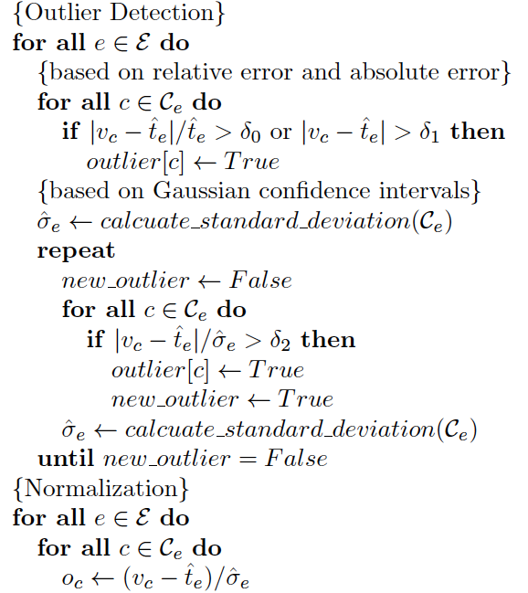
Normalization and Outlier Detection
Leverage truth priors, e.g., median, the most frequent value, or output of any truth-finding algorithms
Remove outliers by absolute error, relative error, and Gaussian confidence interval (with prior truth as mean, iteratively computed variance)
Outliers can significantly shift empirical variance, so update variance after outliers are detected and try to detect outliers based on updated variance
Normalize all claims to standard Gaussian N(0,1)
Prevent biased estimation of source quality
Preprocessing Routine

Slide 40
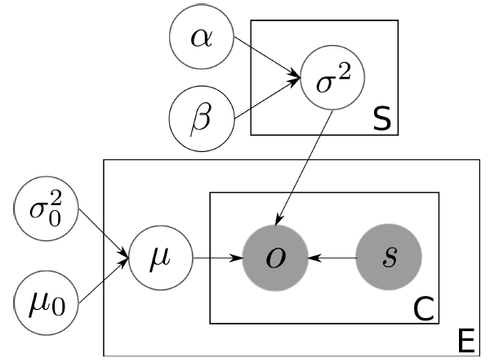
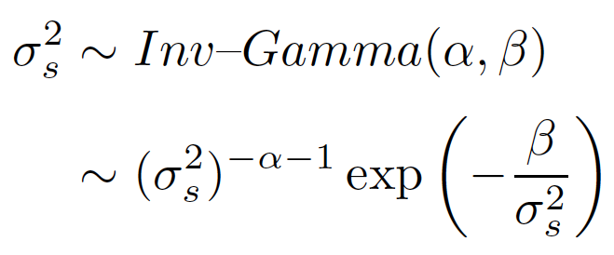
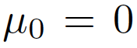
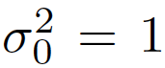
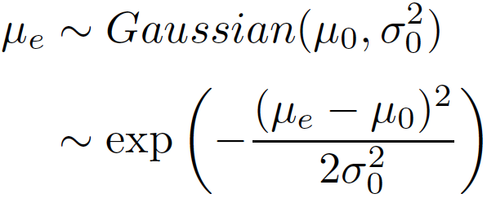
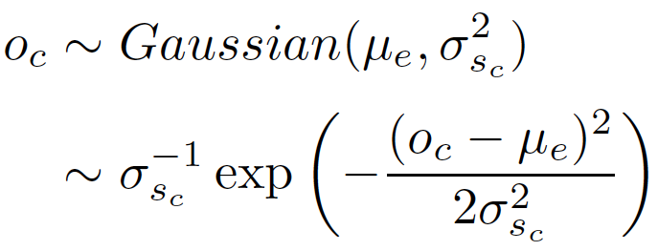
GTM: Truth Generation Mechanism
For each source k
Generate source quality:
For each entity e
Generate its true value:
(set and )
For each claim c of entity e
Generate observation of c:
Quality of Sources
Observation of Claims
True Values of Entities

Slide 41
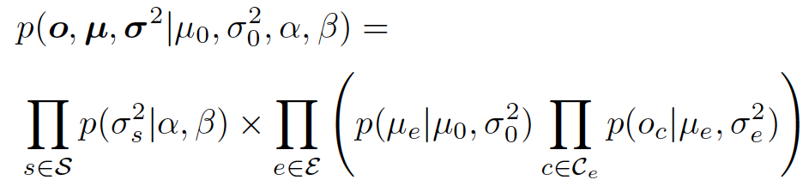
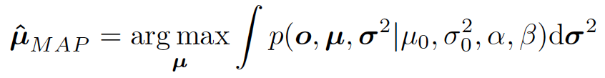
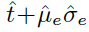
Inference
Likelihood:
MAP Inference of truth:
Many inference algorithms can be applied, e.g. Gibbs sampling, EM, etc.
To get actual truth: , or the closest claimed value

Slide 42
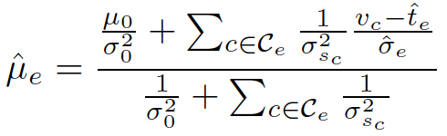
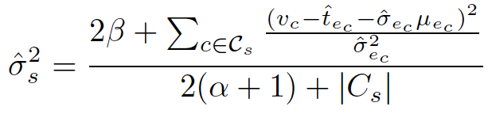
EM Algorithm
Given source quality, optimal truth is:
Given truth, optimal source quality is:
Regularization
Weighted by source quality
How close claims are to the truth
Regularization / smoothing

Slide 43
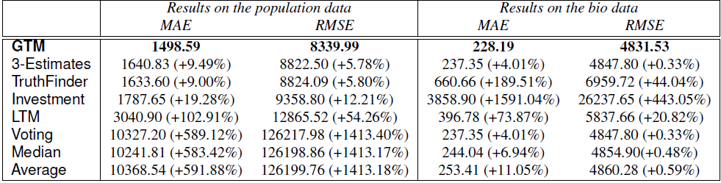
Experiments on Edit History of Wikipedia
Datasets: Edit history of Wikipedia
Population: 2,415 sources; 1,148 city-year; 4,119 claims.
Biography: 607,819 sources; 9,924 dates of birth or death; 1,372,066 claims.
Evaluation: Mean Absolute Error, Root Mean Square Error

Slide 44
Outline
Motivation: Why Truth Finding?
TruthFinder: A Source-Claim-Object Network Framework
Truth Finding: Variations and Extensions
LTM: Latent Truth Model (Modeling Multi-Valued Truth and Two-sided Errors)
GTM: A Gaussian Truth Model for Finding Truth among Numerical Data
Conclusions and Future Research

Slide 45
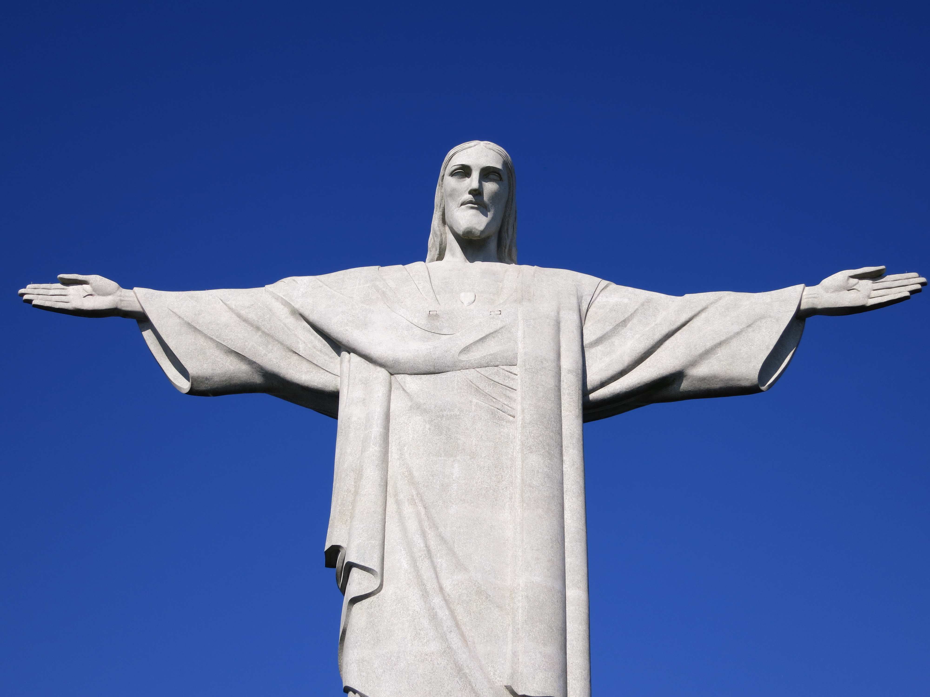

Slide 46
Conclusions
Truth finding: A critical issue in data cleaning, information integration, and quality of information → Information Trust
A fundament framework in Truth Finding:
A Source-Claim-Object network + iterative enhancement
LTM (Latent Truth Model): Modeling multi-valued truth and two-sided errors
Cares subtlety and demonstrates its power on truth modeling
GTM: A Gaussian truth model for numerical data
Integration of methodologies of truth-finding and crowdsourcing
Still a widely open area: Lots more to be studied!!

Slide 47
Selected References on Truth Analysis
Xin Luna Dong, Laure Berti-Equille, and Divesh Srivastava, “Integrating conflicting data: The role of source dependence”, PVLDB, 2(1):550–561, 2009.
Xin Luna Dong, Laure Berti-Equille, and Divesh Srivastava, “Truth discovery and copying detection in a dynamic world”, PVLDB, 2(1):562–573, 2009.
Manish Gupta, Yizhou Sun, and Jiawei Han, “Trust Analysis with Clustering", WWW'11
Guo-Jun Qi, Charu C. Aggarwal, Jiawei Han, and Thomas Huang, "Mining Collective Intelligence in Groups", Proc. of 2013 Int. Conf. on Word Wide Web (WWW'13), Rio de Janeiro, Brazil, May 2013.
Dong Wang, Lance Kaplan, and Tarek Abdelzaher, “On Truth Discovery in Social Sensing with Conflicting Observations: A Maximum Likelihood Estimation Approach”, ACM Transaction on Sensor Networks (TOSN)
Xiaoxin Yin, Jiawei Han, and Philip S. Yu, “Truth Discovery with Multiple Conflicting Information Providers on the Web”, IEEE TKDE, 20(6):796-808, 2008
Bo Zhao, Benjamin I. P. Rubinstein, Jim Gemmell, and Jiawei Han, "A Bayesian Approach to Discovering Truth from Conflicting Sources for Data Integration", PVLDB, 2012
Bo Zhao and Jiawei Han, "A Probabilistic Model for Estimating Real-Valued Truth from Conflicting Sources", Proc. of 10th Int. Workshop on Quality in Databases (QDB'12), Istanbul, Turkey, Aug. 2012.

